Slide 1
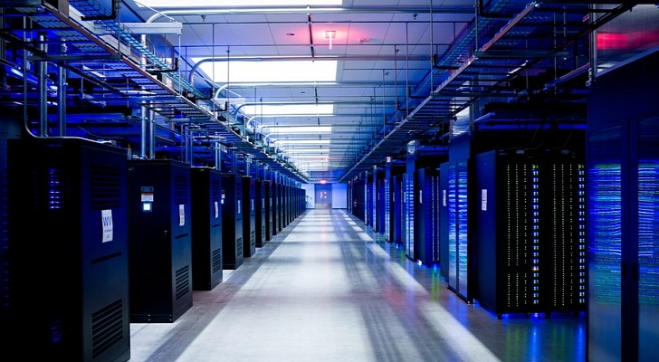

DL Workspace
Open Source Toolkit for Turn-Key AI Cluster
Notes:
We introduce DL Workspace, an open source toolkit for turn-key AI Cluster setup and operation.

Slide 2
DL Workspace is …
Open source toolkit for turn-key AI cluster setup
Used for daily development/production in Microsoft internal groups (e.g., Microsoft Cognitive Services, SwiftKey, Bing Relevance)
Allow AI scientist to run jobs (interactive exploration, training, inferencing, data analytics)
Resource managed by cluster
Turn-key operation (automatic software setup & cluster configuration)
Out-of-box support
All major DL toolkits (TensorFlow, CNTK, Caffe, MxNet, etc..)
Big data analytics (Hadoop/Spark)
Notes:
DL Workspace provides out-of-box support for multiple Deep Learning toolkit, and big data analytical kits. It is used daily by Microsoft employees, and allows AI scientist to run both interactive jobs and batch jobs on cluster.

Slide 3
Installation on-perm
Notes:
The rest of the video explains the process to install DL Workspace in a stand alone, on-perm cluster.

Slide 4
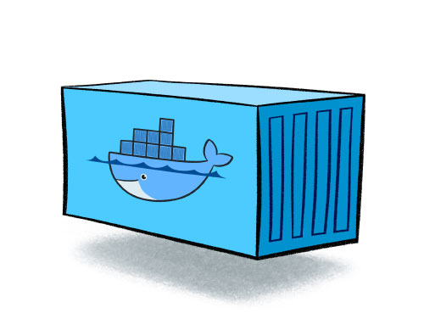
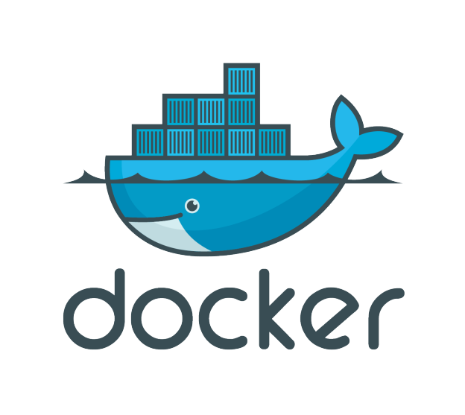

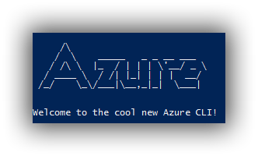

Prepare Dev Box
OR
Installation script for
Notes:
You need a development machine running Ubuntu OS. You may then either install docker, and build DL workspace dev docker, or run installation scripts that will install docker, python and Azure CLI on your machine.

Slide 5
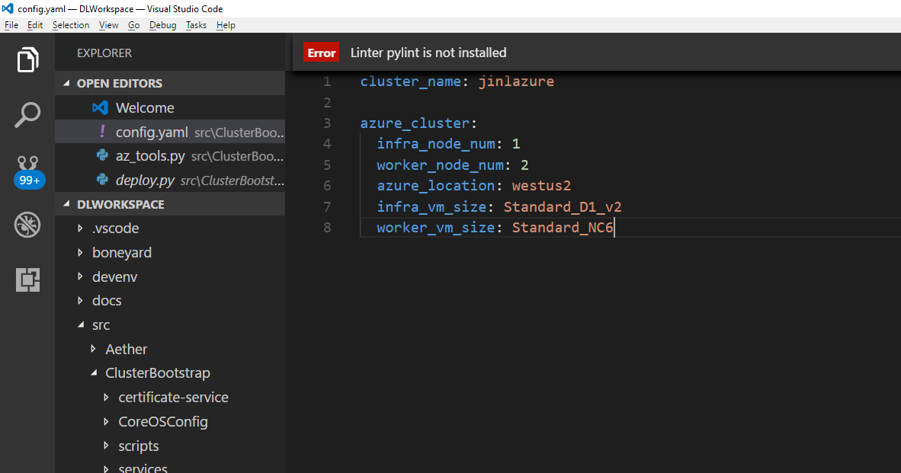
prepare configuration file src/ClusterBootstrap/config.yaml
Notes:
Prepare configuration file.

Slide 6
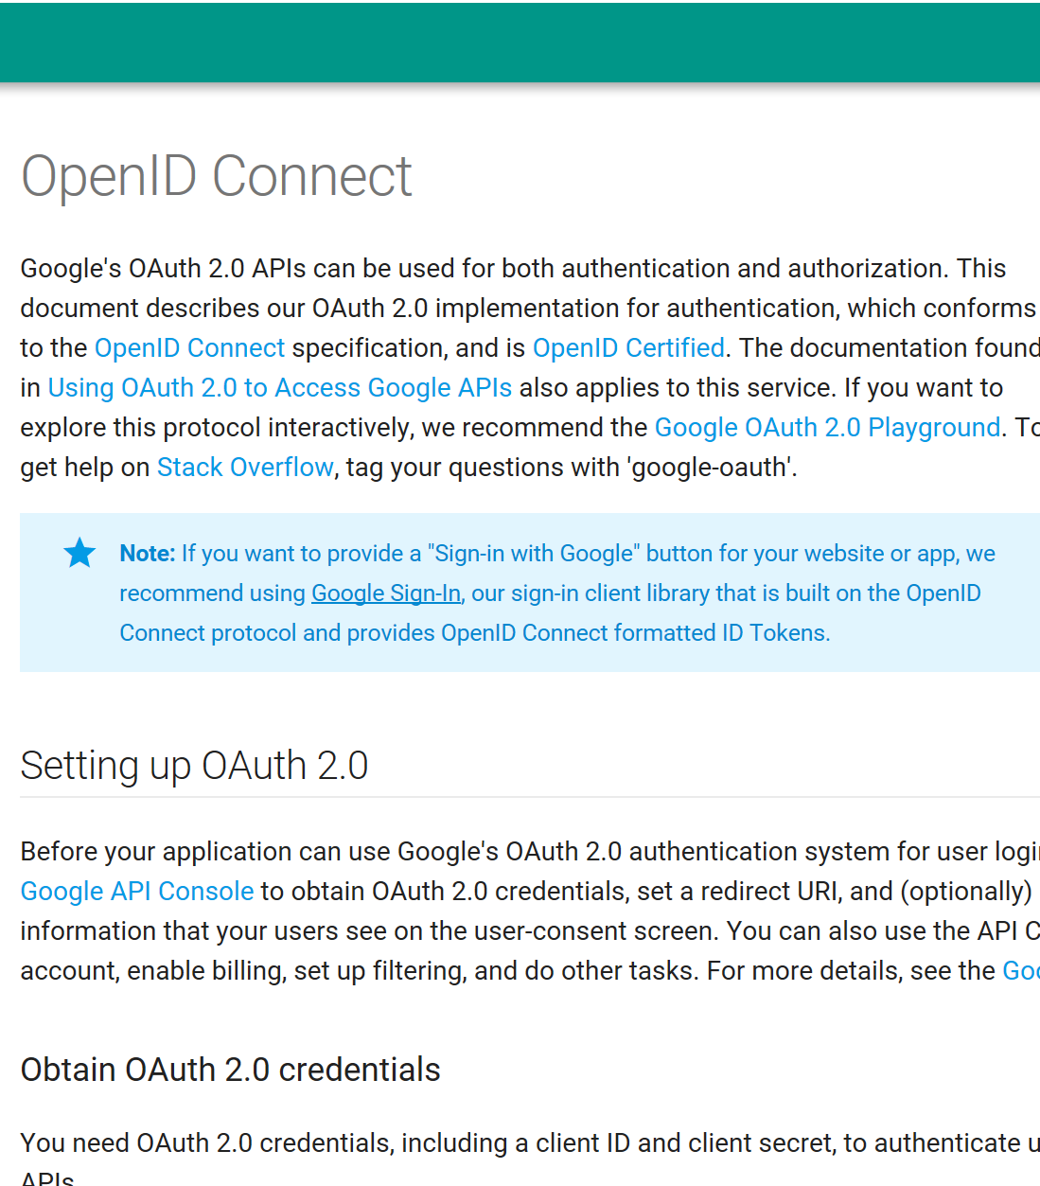
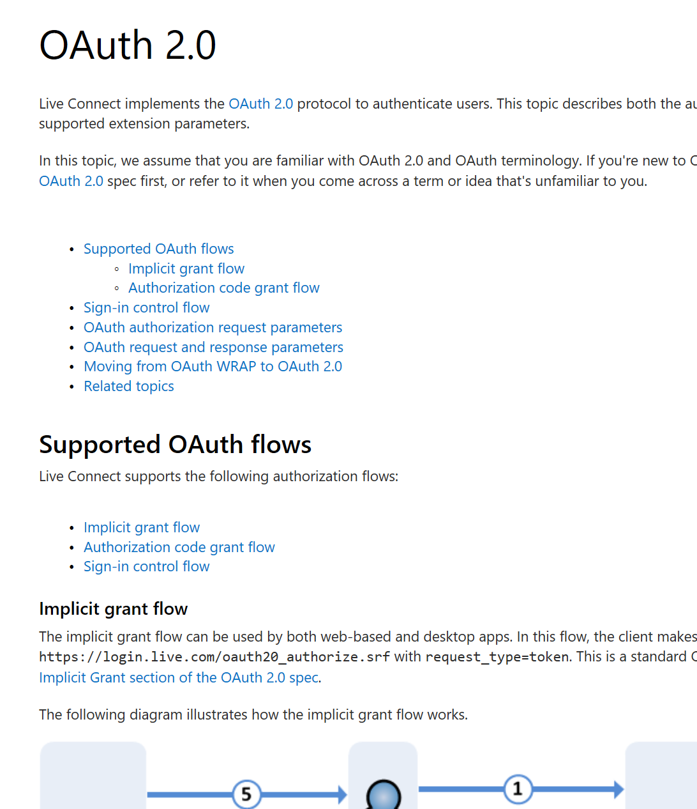
Authentication for Microsoft corp users have been pre-configured, please contact authors for information.
Notes:
Depending on your Open ID provider, configuration the Open ID endpoint, and insert the information into configuration file.

Slide 7
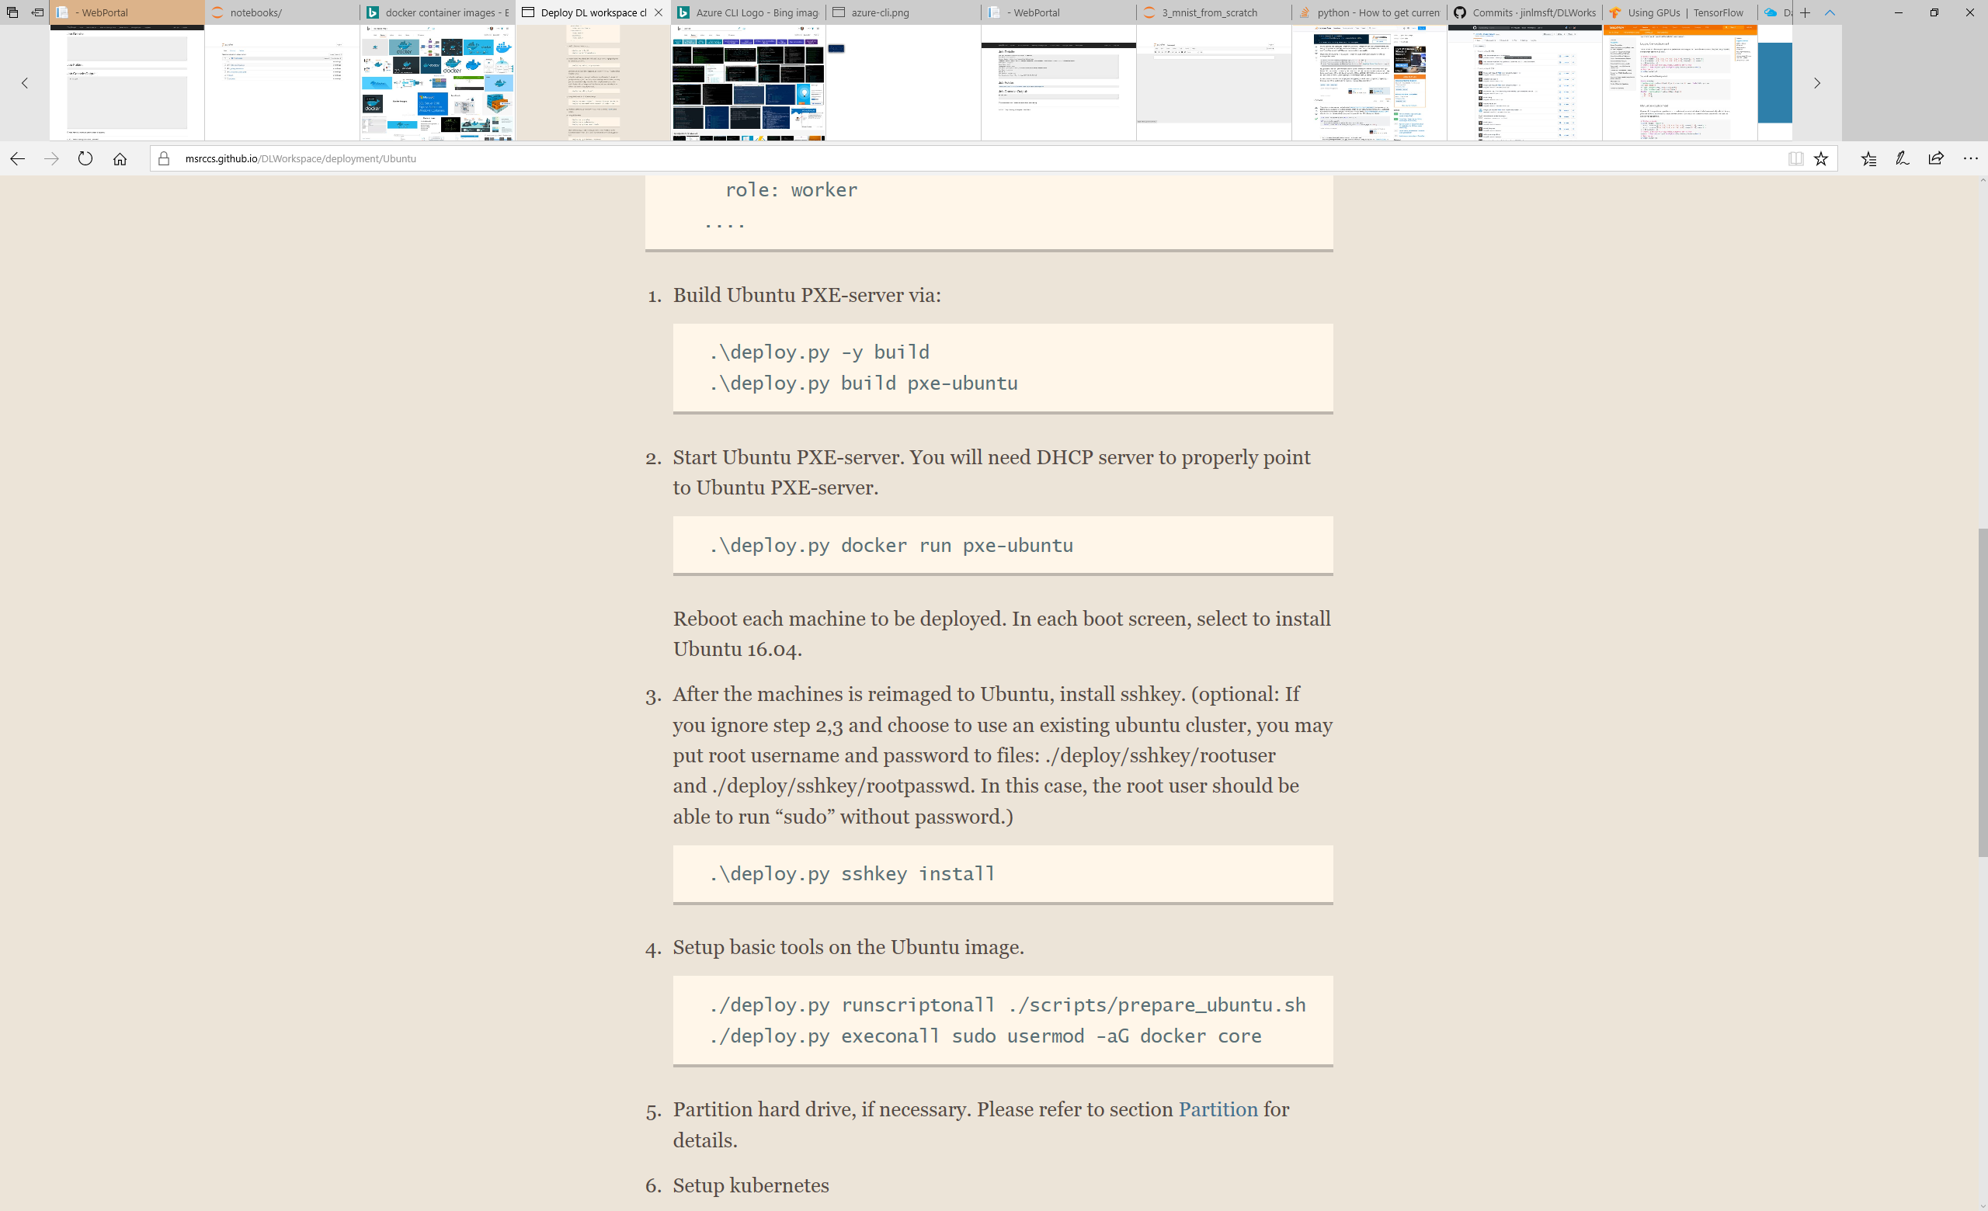
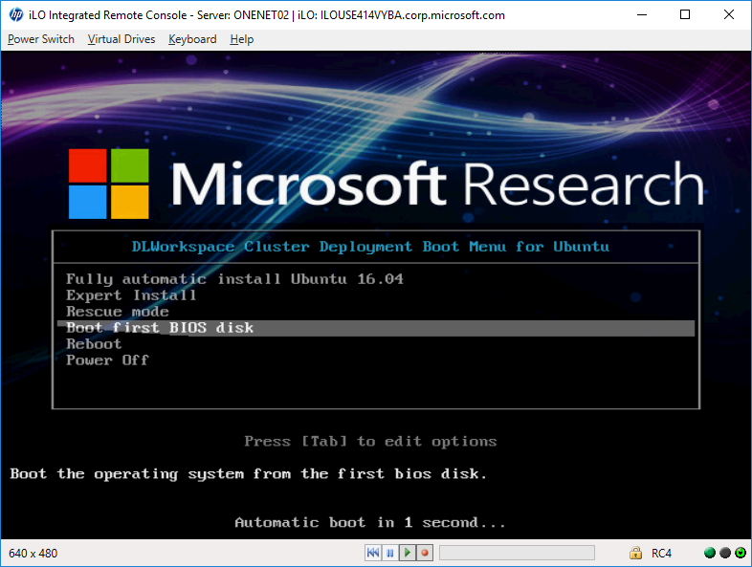
Deploy Ubuntu Cluster
Build Ubuntu PXE docker image
Put machines in a VLAN, run PXE docker, update DHCP server to point to the PXE docker
Use iLO, choose option to fully automatic install Ubuntu 16.04
Notes:
Use enclosed script to configure and build a Ubuntu PXE docker image. Put machines to be deployed in a VLAN, run PXE docker image, and update DHCP server to point to the PXE docker.
Use iLO, choose option to fully automatic install Ubuntu 16.04

Slide 8
Run rest of the scripts to setup DL Workspace
Installing required software package & GPU driver
Configure shared file system (NFS, glusterfs, HDFS)
Configure HDFS/Yarn
Build and launch DL Workspace runtime
[Note] Installation of on-perm cluster depends on the configuration of the cluster. If you run into issues, please contact the authors.
Notes:
Run the rest of the scripts to setup DL Workspace. This include the installation of required software package and GPU driver, configure shared file system (NFS, glusterfs, HDFS), configure HDFS/Yarn, and build and launch DL workspace runtime.

Slide 9
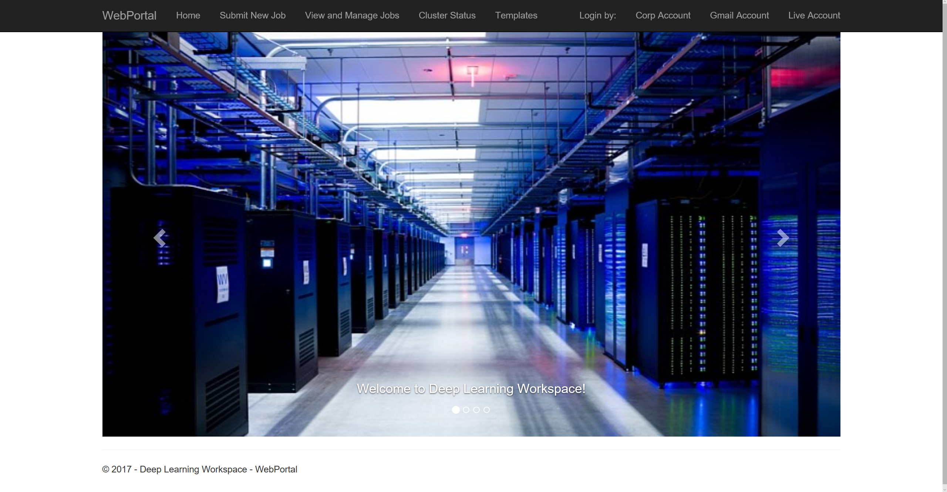
You should have a fully functional cluster then.
Notes:
Once all scripts run through, please wait a few minutes for the container to start. You should have a fully functional cluster then.

